Slide 1
Java Programming
August 6, 2009

Slide 2
References:
Text Books:
Herbert Schildt , “The Complete Reference Java Seventh Edition” Tata McGraw-Hill, reprint 2007.
PratikPatel & KarlMoss , ”Java database programming with JDBC” DreamTech, New Delhi, second edition, 2000.
Reference:
Steven Holzner, “Java 2 programming black book” , DreamTech, NewDelhi, reprint: 2005.

Slide 3
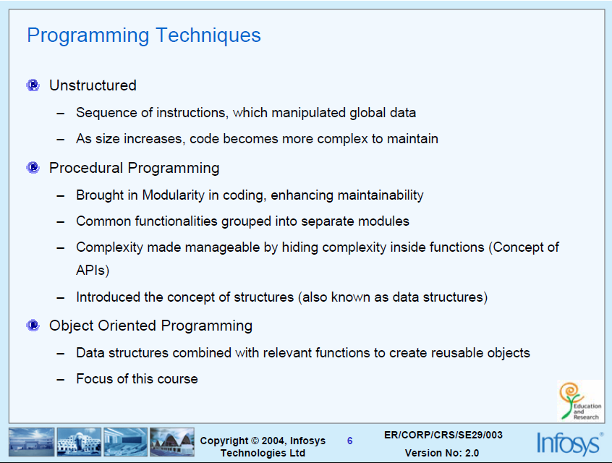


Slide 4
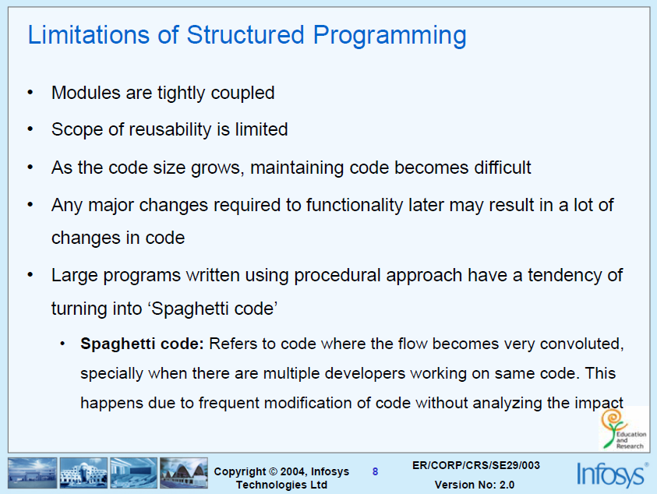

Slide 5
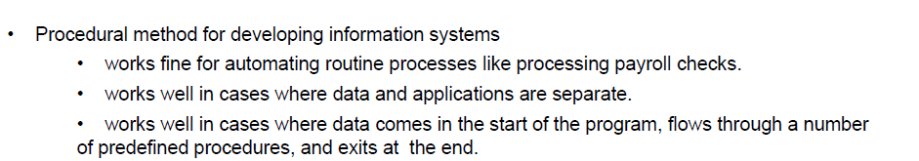
Contd…

Slide 6
Object oriented methodology

Slide 7
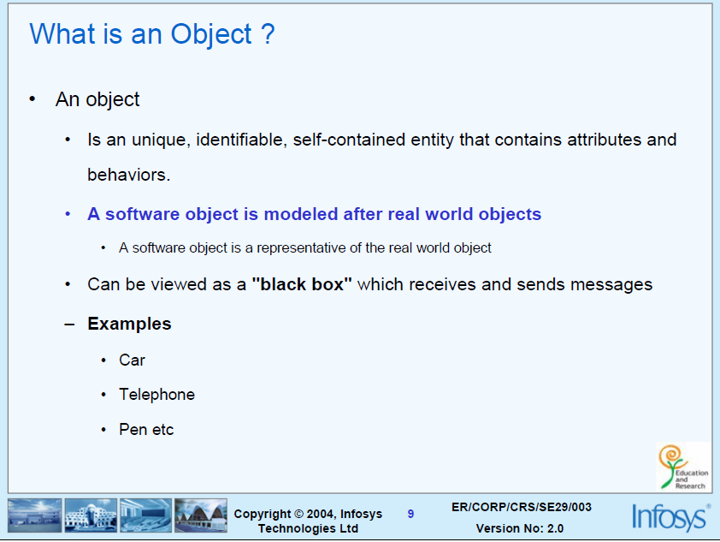

Slide 8
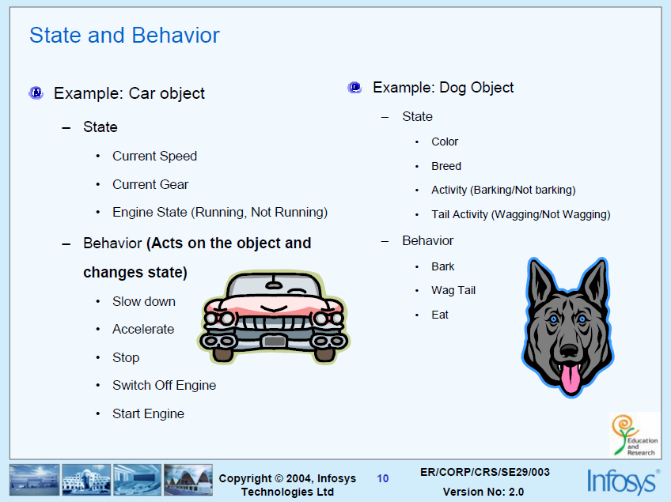

Slide 9
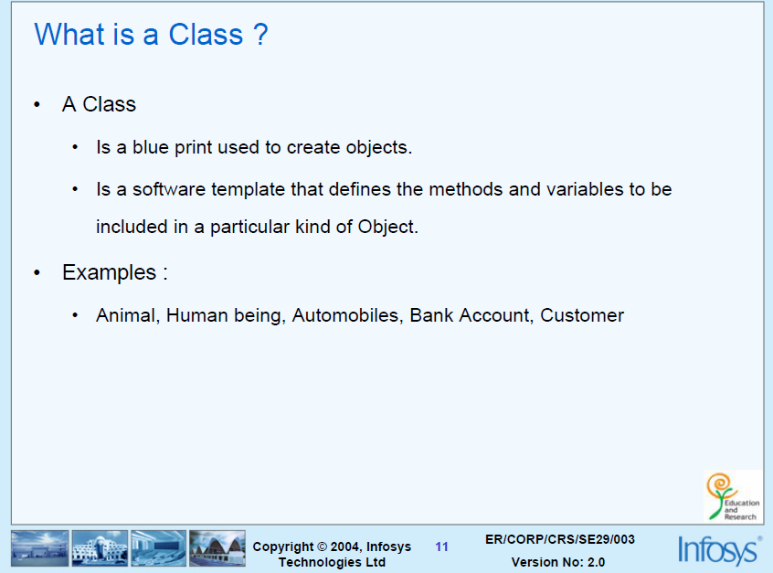

Slide 10
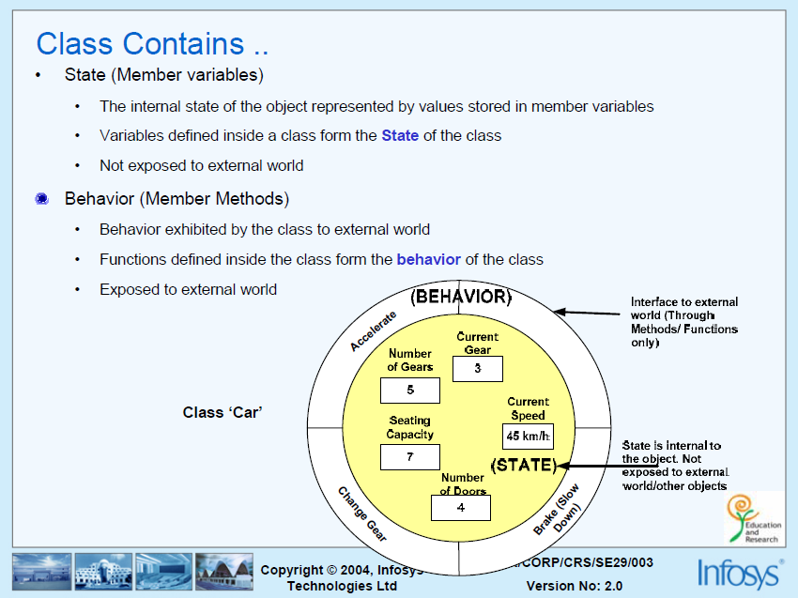

Slide 11
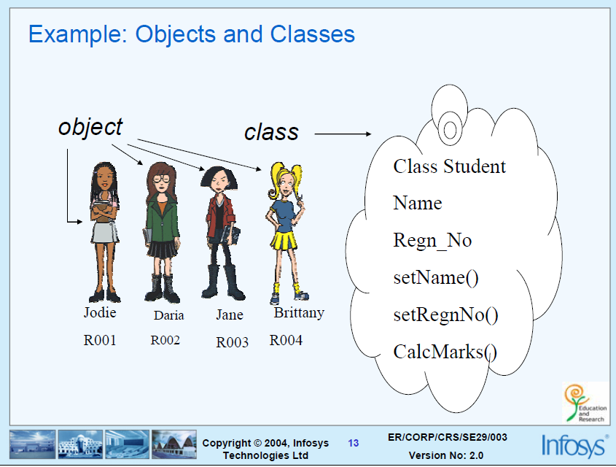

Slide 12
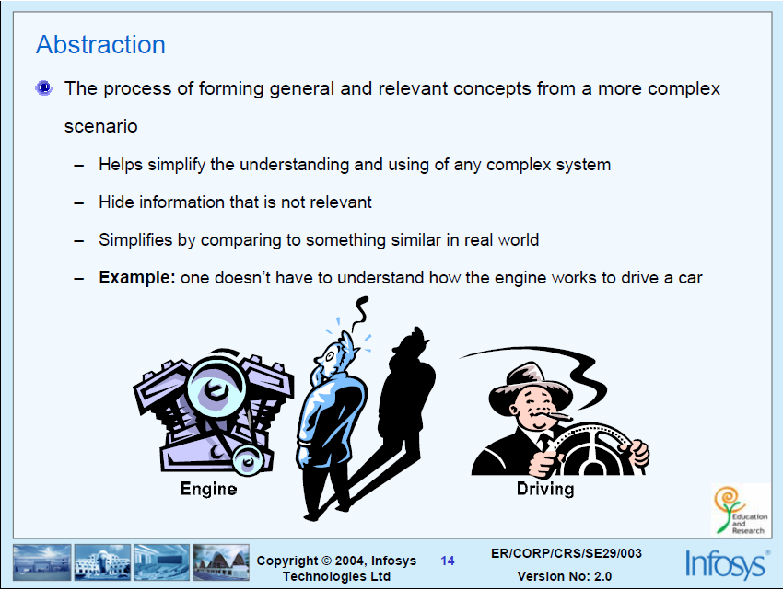

Slide 13
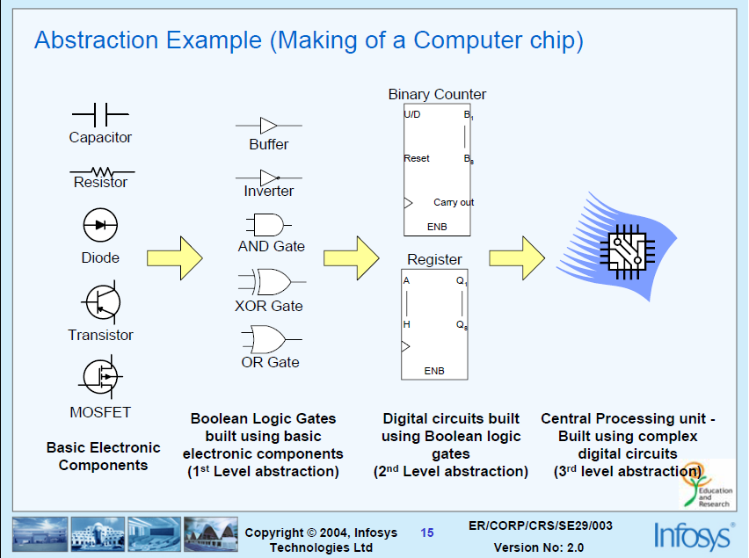

Slide 14
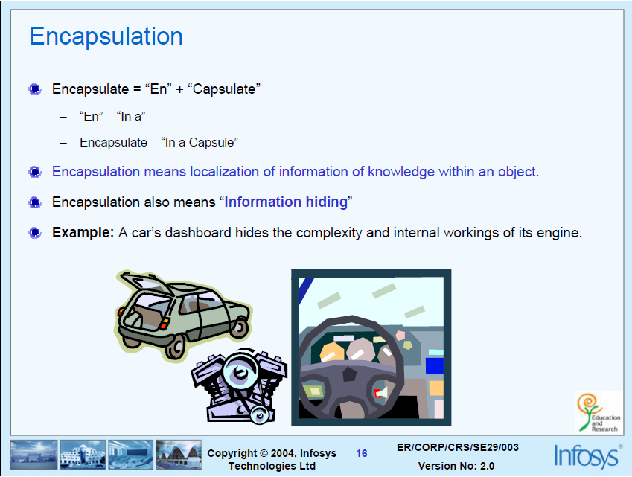

Slide 15
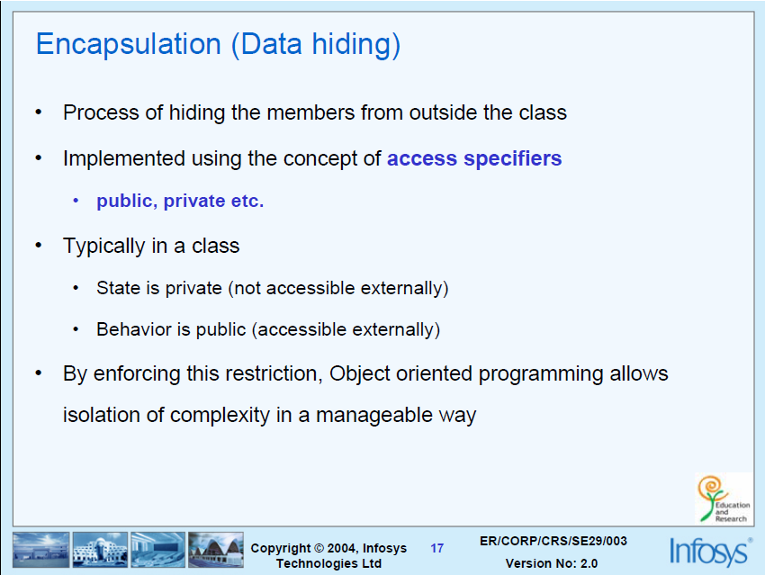

Slide 16
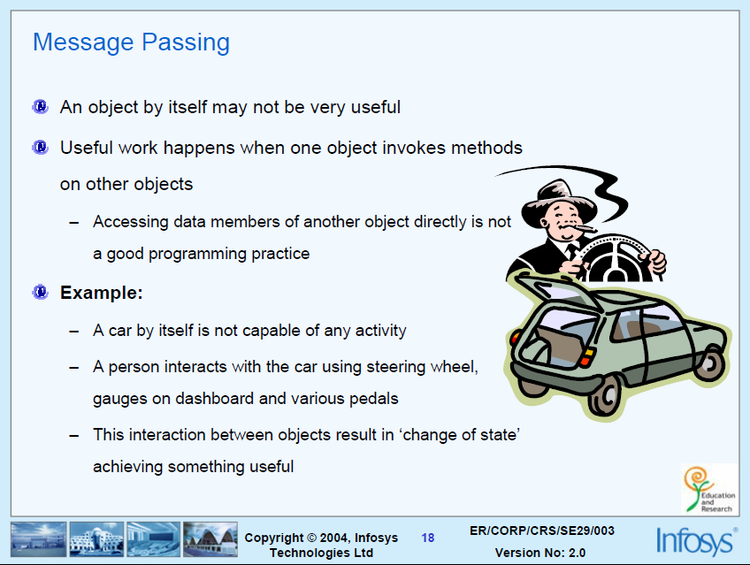

Slide 17
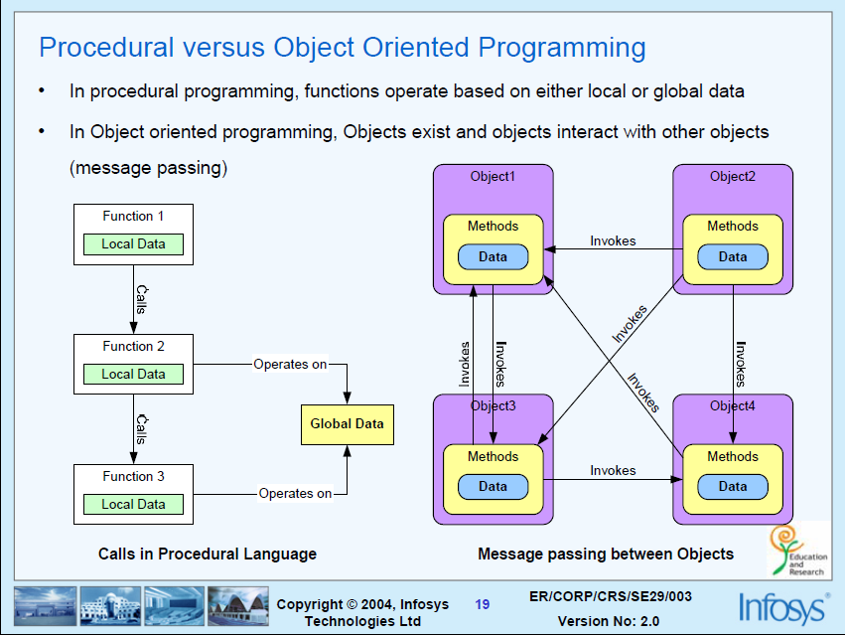

Slide 18
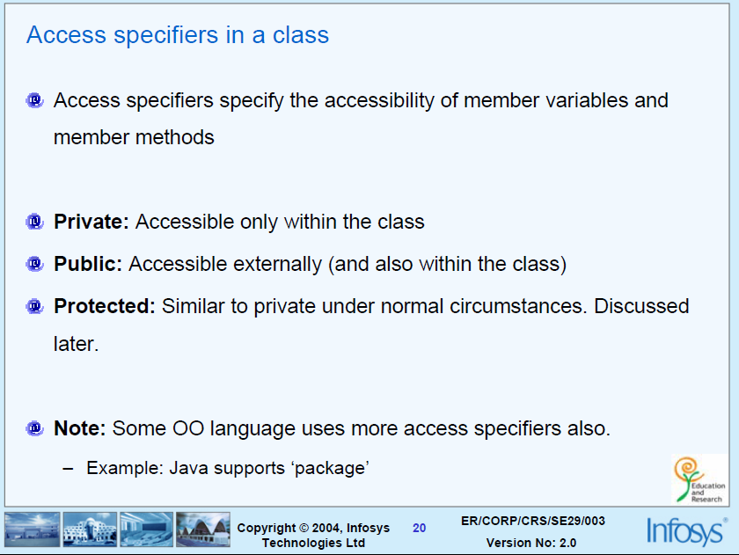

Slide 19
Contd…
Inheritance:
Polymorphism:

Slide 20
INTRODUCTION TO JAVA
August 6, 2009

Slide 21
Java Tutorial
Write Once, Run Anywhere

Slide 22
Java - General
Java is:
  platform independent programming language
  similar to C++ in syntax
  similar to Smalltalk in mental paradigm
Pros: also ubiquitous to net
Cons: interpreted, and still under development (moving target)

Slide 23
Java - General
Java has some interesting features:
  automatic garbage collection,
  simplifies pointers; no directly accessible pointer to memory,
  simplified network access,
  multi-threading!

Slide 24
Java is related to C++, which is a direct descendent of C
From C, Java derives its syntax
Many of Java’s object-oriented features were influenced by C++
Java was conceived by James Gosling, Patrick Naughton, Chris Warth, Ed Frank, and Mike Sheridan at Sun Microsystems, Inc. in 1991
August 6, 2009

Slide 25
How it works…!
Compile-time Environment
Compile-time Environment
Class Loader
Bytecode
Verifier
Java Class
Libraries
Java
Source
(.java)
Java
Interpreter
Just in Time
Compiler
Java
Bytecodes
move locally
or through
network
Java
Virtual
machine
Java
Compiler
Runtime System
Java
Bytecode
(.class )
Operating System
Hardware

Slide 26
How it works…!
Java is independent only for one reason:
  Only depends on the Java Virtual Machine (JVM),
  code is compiled to bytecode, which is interpreted by the resident JVM,
  JIT (just in time) compilers attempt to increase speed.

Slide 27
This language was initially called “Oak” but was renamed “Java” in 1995
Java can be used to create two types of programs: applications and applets
An application is a program that runs on your computer, under the operating system of that computer
An applet is an application designed to be transmitted over the Internet and executed by a Java-compatible Web browser
August 6, 2009

Slide 28
An applet is actually a tiny Java program, dynamically downloaded across the network, just like an image, sound file, or video clip
An applet is a program that can react to user input and dynamically change—not just run the same animation or sound over and over
August 6, 2009

Slide 29
Security
When you use a Java-compatible Web browser, you can safely download Java applets without fear of viral infection or malicious intent
Java achieves this protection by confining a Java program to the Java execution environment and not allowing access to other parts of the computer environment
Java is portable across many types of computers and operating systems that are in use throughout the world
August 6, 2009

Slide 30
Java’s Magic: The Bytecode
The output of a Java compiler is not executable code ; rather, it is bytecode
Bytecode is a highly optimized set of instructions designed to be executed by the Java run-time system, which is called the Java Virtual Machine (JVM)
August 6, 2009

Slide 31


Slide 32
JVM is an interpreter for bytecode
August 6, 2009

Slide 33
Translating a Java program into bytecode helps makes it much easier to run a program in a wide variety of environments
The reason is straightforward: only the JVM needs to be implemented for each platform
When a program is interpreted, it generally runs substantially slower than it would run if compiled to executable code
The use of bytecode enables the Java run-time system to execute programs much faster than you might expect
August 6, 2009

Slide 34
Sun supplies its Just In Time (JIT) compiler for bytecode, which is included in the Java 2 release
When the JIT compiler is part of the JVM, it compiles bytecode into executable code in real time, on a piece-by-piece, demand basis
The JIT compiler compiles code as it is needed, during execution
August 6, 2009

Slide 35
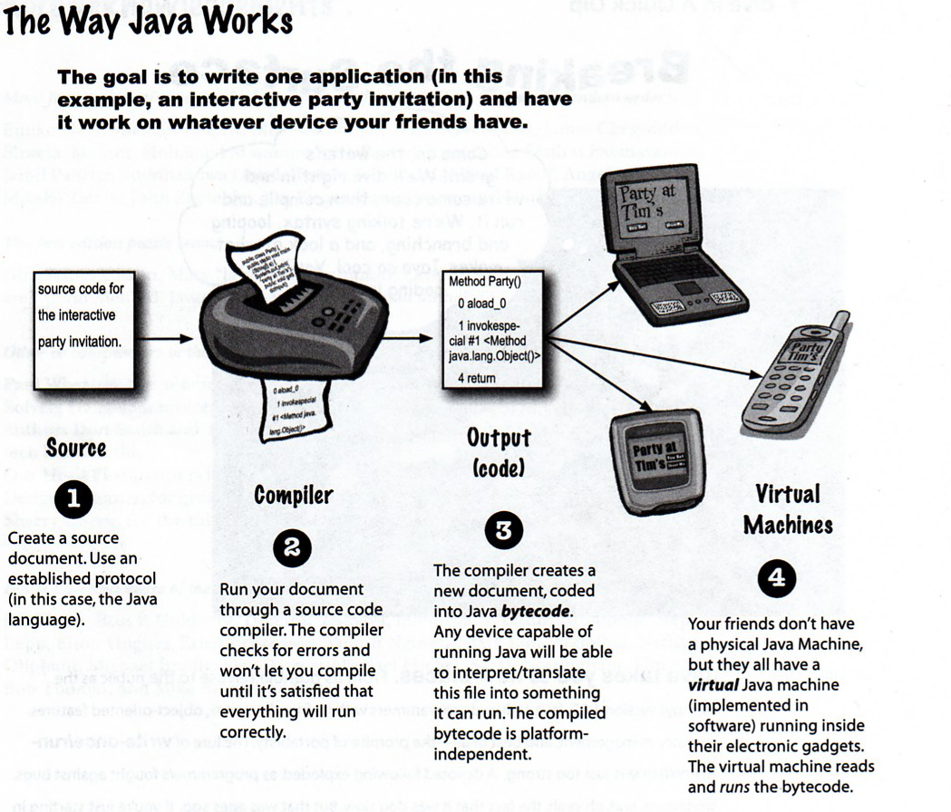
August 6, 2009

Slide 36
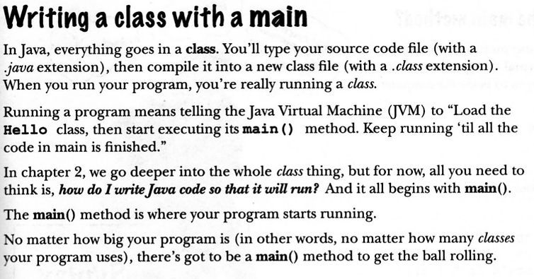
August 6, 2009

Slide 37
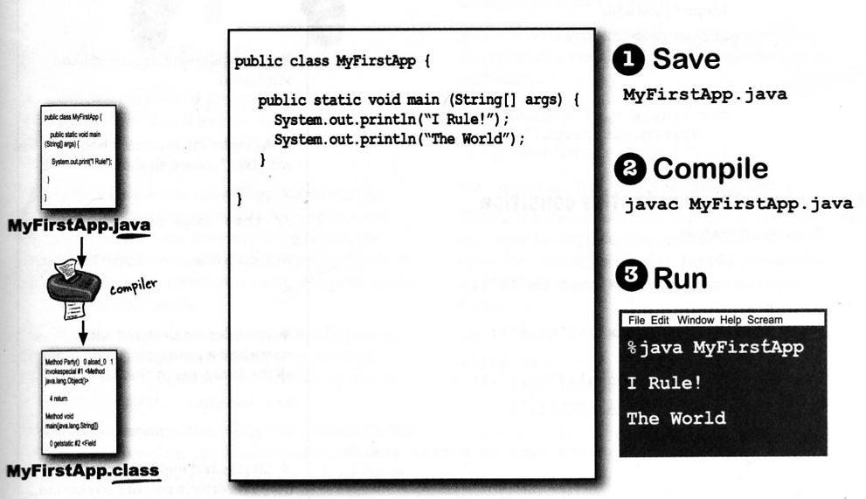
August 6, 2009

Slide 38
The Java Buzzwords
Simple
Secure
Portable
Object-oriented
Robust
Multithreaded
Architecture-neutral
Interpreted & High performance
Distributed
Dynamic
These explain the design goals and accomplishments!
August 6, 2009

Slide 39
Simple
If you already understand the basic concepts of object-oriented programming, learning Java will be even easier
Because Java inherits the C/C++ syntax and many of the object-oriented features of C++, most programmers have little trouble learning Java
Beyond its similarities with C/C++, Java has another attribute that makes it easy to learn: it makes an effort not to have surprising features
August 6, 2009

Slide 40
Object oriented
Java was not designed to be source-code compatible with any other language
The object model in Java is simple and easy to extend, while simple types, such as integers, are kept as high-performance non-objects
August 6, 2009

Slide 41
Robust
Ability to create robust programs was given a high priority in the design of Java
To better understand how Java is robust, consider two of the main reasons for program failure: memory management mistakes and mishandled exceptional conditions (that is, run-time errors)
August 6, 2009

Slide 42
Memory management can be a difficult, tedious task in traditional programming environments
For example, in C/C++, the programmer must manually allocate and free all dynamic memory
Programmers will either forget to free memory that has been previously allocated or, worse, try to free some memory that another part of their code is still using
August 6, 2009

Slide 43
Pointers- power of pointers with out them
Java virtually eliminates these problems by managing memory allocation and deallocation for you
Java provides object-oriented exception handling
August 6, 2009

Slide 44
Multithreaded
Java supports multithreaded programming, which allows you to write programs that do many things simultaneously
The Java run-time system comes with an elegant yet sophisticated solution for multiprocess synchronization that enables you to construct smoothly running interactive systems
August 6, 2009

Slide 45
Architecture-Neutral
Operating system upgrades, processor upgrades, and changes in core system resources can all combine to make a program malfunction
Java designers made several hard decisions in Java language and Java Virtual Machine in an attempt to alter this situation
Their goal was “write once; run anywhere, any time, forever.” ( W O R A )
August 6, 2009

Slide 46
Interpreted and High Performance
Java enables the creation of cross-platform programs by compiling into an intermediate representation called Java bytecode
This code can be interpreted on any system that provides a Java Virtual Machine
the Java bytecode was carefully designed so that it would be easy to translate directly into native machine code for very high performance by using a just-in-time compiler
August 6, 2009

Slide 47
Distributed
Java is designed for the distributed environment of the Internet, because it handles TCP/IP protocols
Remote Method Invocation (RMI) feature of Java brings an unparalleled level of abstraction to client/server programming
August 6, 2009

Slide 48
Dynamic
Java programs carry with them substantial amounts of run-time type information that is used to verify and resolve accesses to objects at run time.
Makes it possible to dynamically link code in a safe and expedient manner.
August 6, 2009

Slide 49
An Overview of Java
August 6, 2009

Slide 50
Object-oriented programming is at the core of Java
all computer programs consist of two elements: code and data
A program can be conceptually organized around its code or around its data
August 6, 2009

Slide 51
That is, some programs are written around “what is happening” and
others are written around “who is being affected.”
The first way is called the process-oriented model
The process-oriented model can be thought of as code acting on data
August 6, 2009

Slide 52
The second approach, Object-oriented programming organizes a program around its data (that is, objects) and a set of well-defined interfaces to that data
Characterized as data controlling access to the code
August 6, 2009

Slide 53
Concept of Abstraction – focus is on essential features.
Humans manage complexity through abstraction which is through the use of hierarchical classifications.
Data can be transformed into component objects. A sequence of process steps can become a collection of messages between these objects - essence of OOP
August 6, 2009

Slide 54
The Three OOP Principles:
Encapsulation - is the mechanism that binds together code and the data it manipulates, and keeps both safe from outside interference and misuse – class, member variables and methods
Inheritance - the process by which one object acquires the properties of another object
August 6, 2009

Slide 55
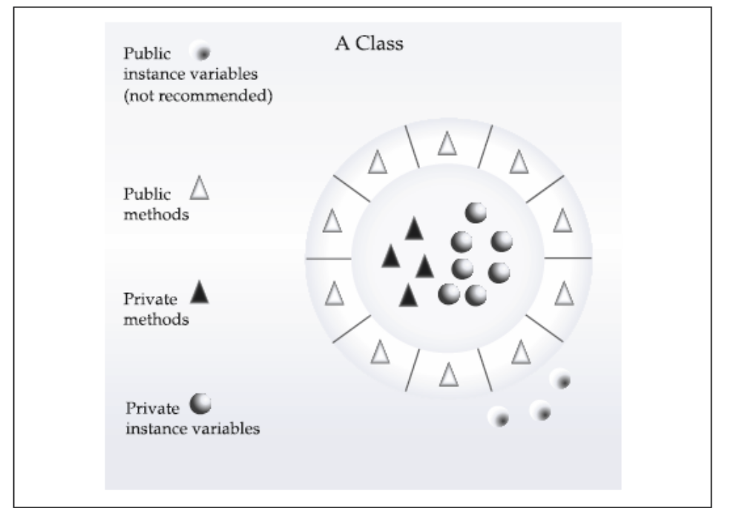
August 6, 2009

Slide 56
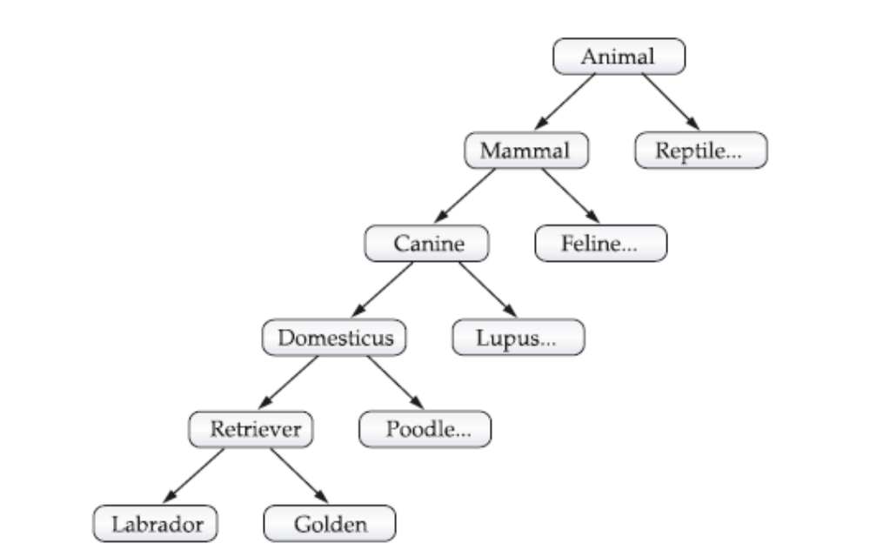
August 6, 2009

Slide 57
Polymorphism - is a feature that allows one interface to be used for a general class of actions – “ one interface , multiple methods”
Polymorphism, encapsulation and inheritance works together - every java program involves these.
August 6, 2009

Slide 58
A First Simple Program
/* This is a simple Java program.
Call this file "Example.java".*/
class Example {
// Your program begins with a call to main().
public static void main(String args[]) {
System.out.println("This is a simple Java program.");
}
}
August 6, 2009

Slide 59
Compiling the Program
C:\>javac Example.java
The javac compiler creates a file called Example.class that contains the bytecode version of the program
The output of javac is not code that can be directly executed
August 6, 2009

Slide 60
To actually run the program, you must use the Java interpreter, called java.
C:\>java Example
When a class member is preceded by public, then that member may be accessed by code outside the class in which it is declared
August 6, 2009

Slide 61
The keyword static allows main( ) to be called without having to instantiate a particular instance of the class
The keyword void simply tells the compiler that main( ) does not return a value
String[ ] args declares a parameter named args, which is an array of instances of the class String. args receives any number of command-line arguments.
August 6, 2009

Slide 62
A Second Short Program
class Example2 {
public static void main(String args[]) {
int num; // this declares a variable called num
num = 100; // this assigns num the value 100
System.out.println("This is num: " + num);
num = num * 2;
System.out.print("The value of num * 2 is ");
System.out.println(num);
}
}
August 6, 2009

Slide 63
Why filename should be same as main class name….
public class MyTable
{
MyList headers =new MyList();
MyDBConnection conn= new MyDBConnection() ;
. . . .
public static void main(String [] args) {
. . . .
} }
You should save this source code in the file "MyTable.java".
When you compile it, it will produce "MyTable.class".
However, when compiling MyTable.java, the compiler notices
that you used classes MyList and MyDBConnection. It will
first look for MyList.class. If it cannot find it, then it
will look for MyList.java to be compiled. If it finds
MyList.java, it compiles it to MyList.class and everything
goes fine. If it cannot find the source code for the
class "MyList", then the compilation of MyTable will
almost certainly fail with a message about an undefined
class.

Slide 64
javac MyTable.java
However, when compiling MyTable.java, the compiler notices that you used classes MyList and MyDBConnection. It will first look for MyList.class. If it cannot find it, then it
will look for MyList.java to be compiled. If it finds MyList.java, it compiles it to MyList.class and everything goes fine. If it cannot find the source code for the class "MyList", then the compilation of MyTable will
almost certainly fail with a message about an undefined class.

Slide 65
Two Control Statements
The if Statement:
if(condition) statement;
if(num < 100)
System.out.println("num is less than 100");
August 6, 2009

Slide 66
The for Loop:
for(initialization; condition; iteration) statement;
class ForTest {
public static void main(String args[]) {
int x;
for(x = 0; x<10; x = x+1)
System.out.println("This is x: " + x);
}
}
August 6, 2009

Slide 67
Using Blocks of Code:
using { and }
August 6, 2009

Slide 68
Lexical Issues
Whitespace:
  Java is a free-form language
  In Java, whitespace is a space, tab, or newline
Identifiers:
- Identifiers are used for class names, method names, and variable names
- Java is case-sensitive
August 6, 2009

Slide 69
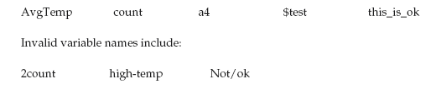
August 6, 2009

Slide 70

Literals:
A constant value in Java is created by using a literal representation of it
August 6, 2009

Slide 71
Comments
There are three types of comments defined by Java.
Single-line (// )and multiline (/* */ )
The third type is called a documentation comment
This type of comment is used to produce an HTML file that documents your program
The documentation comment begins with a /** and ends with a */
August 6, 2009

Slide 72
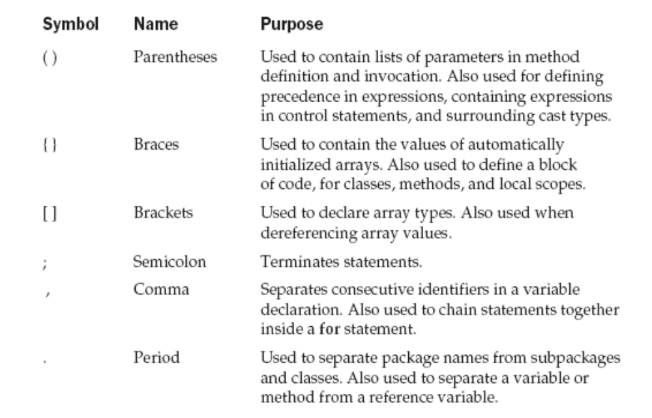
Separators
August 6, 2009

Slide 73
The Java Keywords
There are 50 reserved keywords currently defined in the Java language
Can not be used as names for a variable, class, or method.
const and goto are reserved but not used
Also reserves true, false and null – values defined by Java.
August 6, 2009

Slide 74
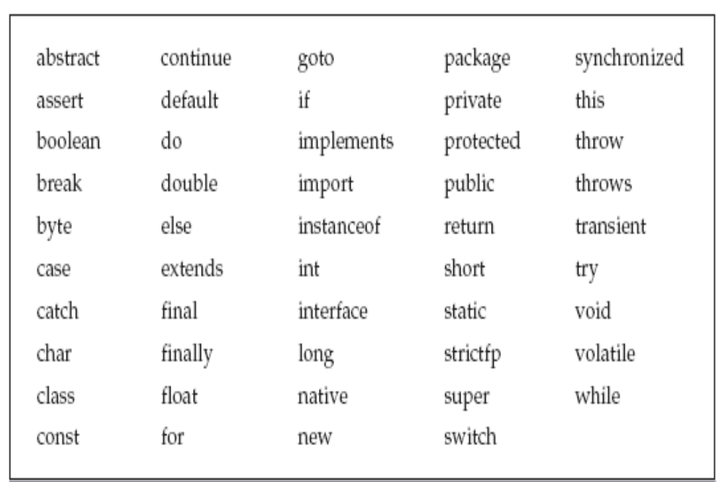
August 6, 2009

